Slide 1
National Hydrology Project - Project and Environmental Management
Charu Jain, Environmental Specialist, The World Bank

Slide 2
Project Activities
Component A: Strengthening of State-Level Water Institutions and Inter-Sector Coordination
Component B: Modernization and Rehabilitation of Irrigation and Drainage Systems
Component C: Consolidation and Enhancement of Irrigation Institutional Reforms
Component D: Enhancing Agriculture Productivity and On-Farm Water Management
Component E: Next Phase
Component F: Project Coordination and Monitoring

Slide 3
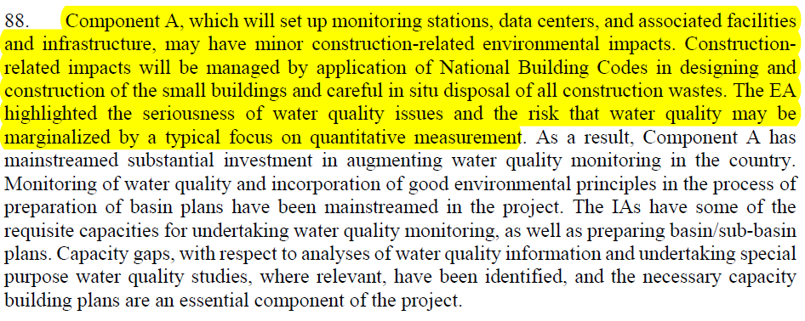
Environmental Appraisal as per PAD

Slide 4
Important Steps
Screening of Works
Preparation of Environment Management Plan (EMP)
Incorporating EM requirements in bid documents for preparation of ESHS-MSIP
Ensuring quality of ESHS-MSIP
Monitoring implementation of EM requirements

Slide 5
Environment Management Plan
S. No. | Potential Impact | Mitigation Measure | Associated Cost | Responsible Agency for Implementation

Slide 6
ESHS-MSIP
Guidelines will be shared by NPMU – under revision

Slide 7
Questions

